Slide 1
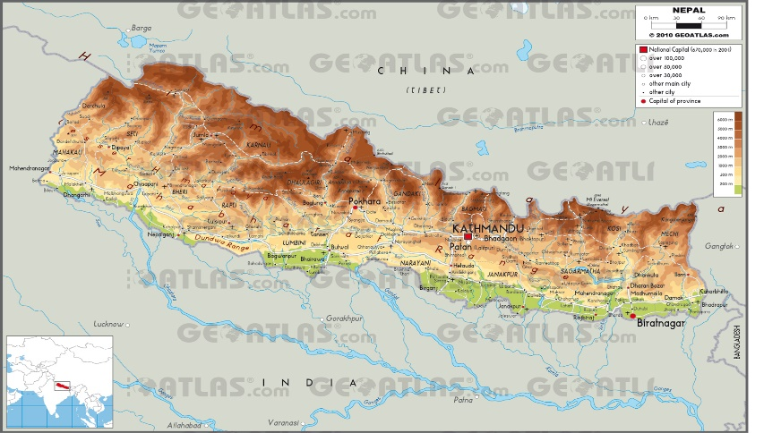
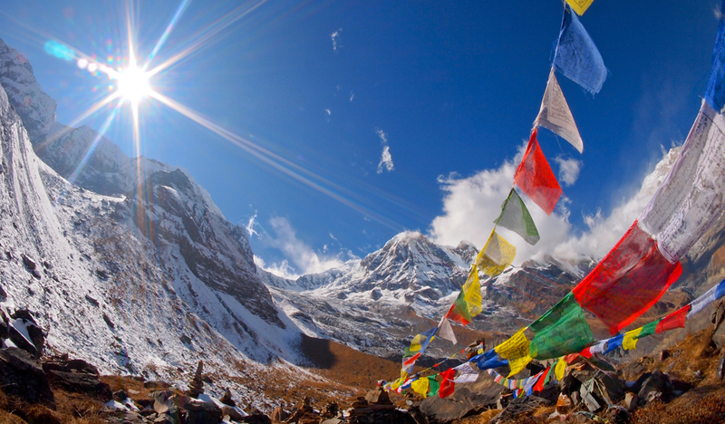
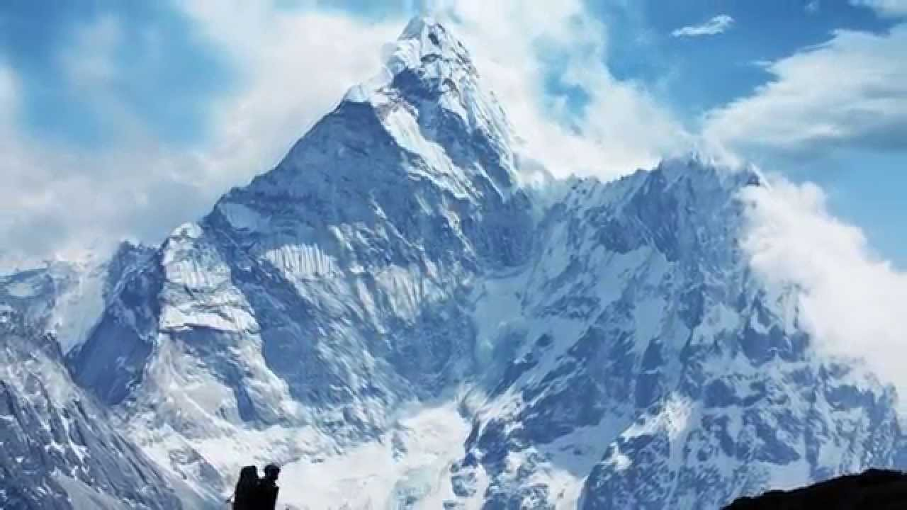
Nepal
Tejuswe Div Gurung
10/1/2015

Slide 2
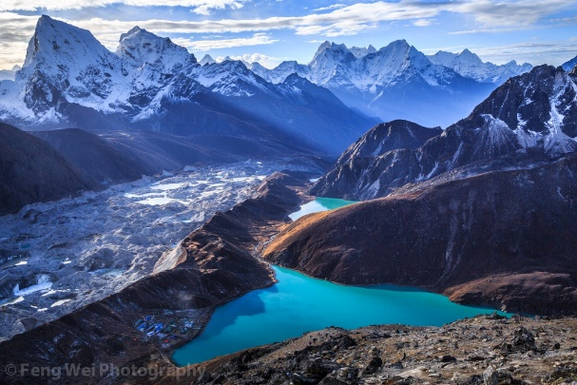
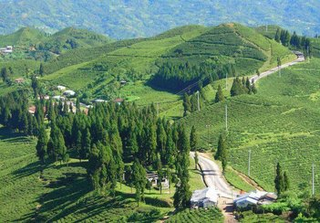
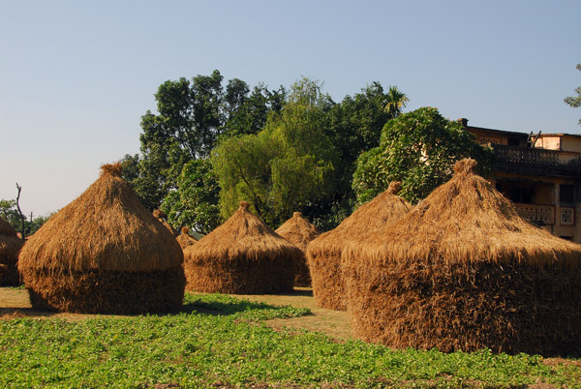
Geography
Himalayan
mountains
Hills and
Plain

Slide 3
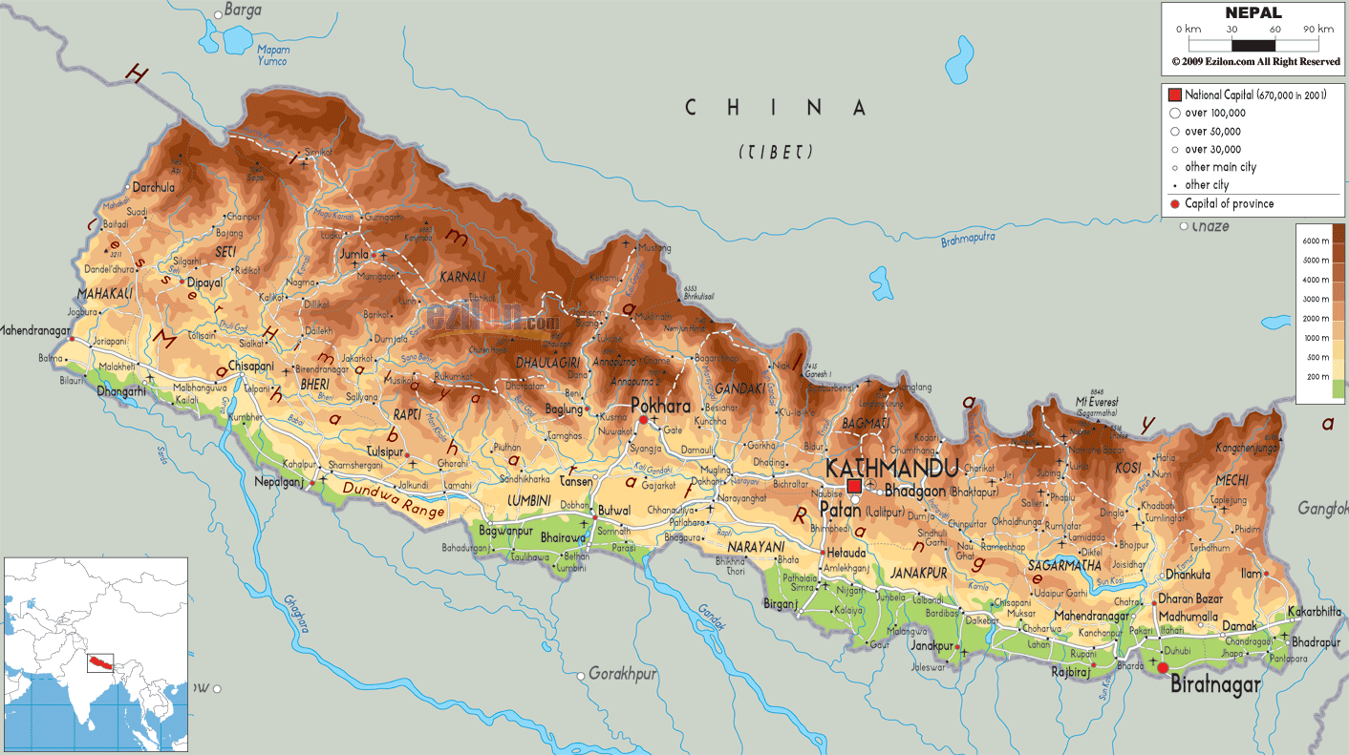
history
The history of Nepal has been influenced by its position in the Himalayas and its two neighbours, modern day India and China.

Slide 4
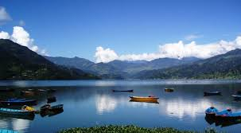
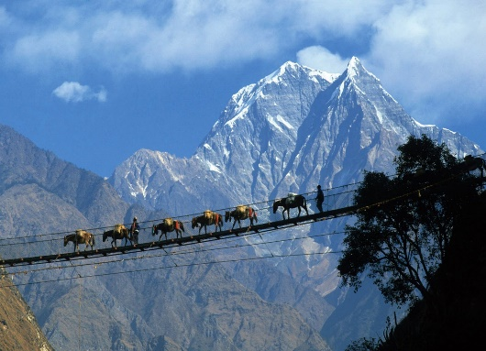
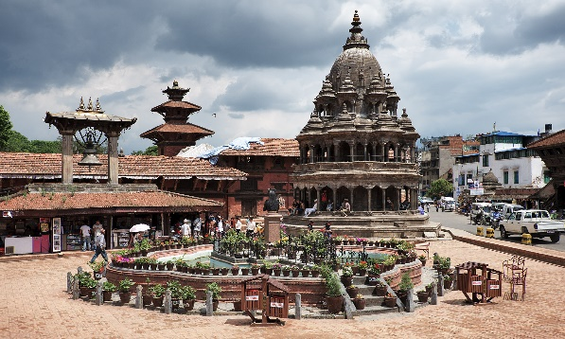
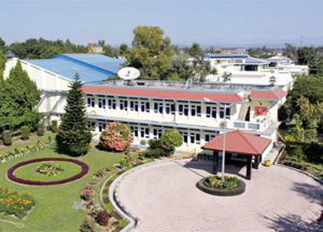
Important cities
Kathmandu, central region
Pokhara, western region
Patan, central region
Biratnagar, eastern region

Slide 5
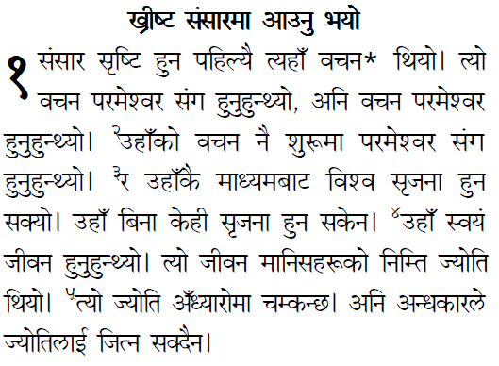
Languages Spoken
Nepali

Slide 6
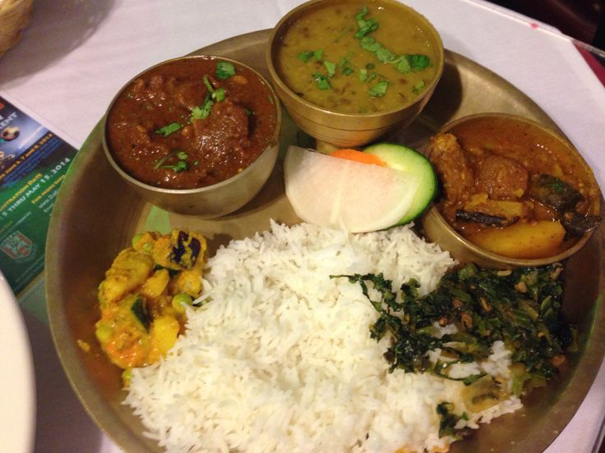
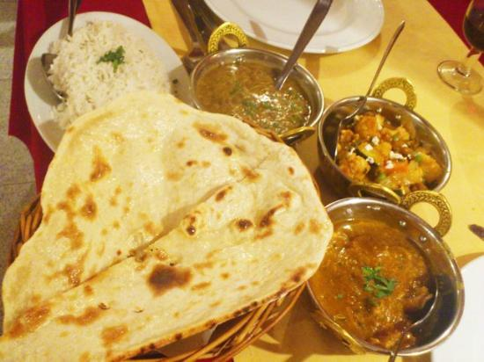
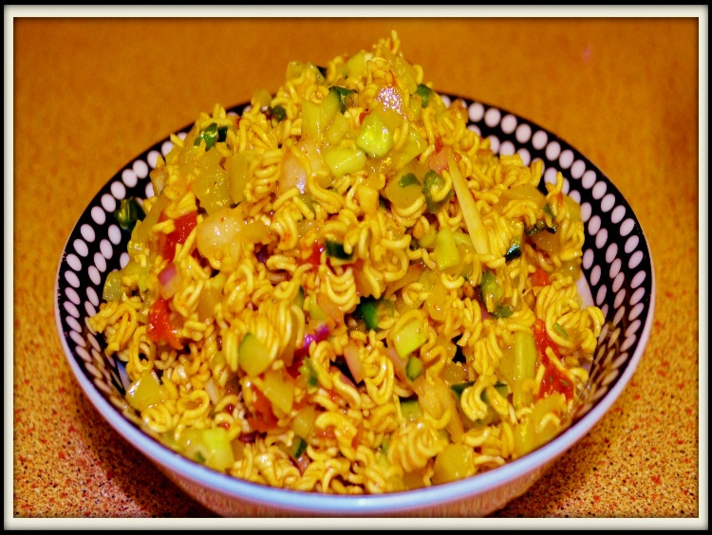
Food of Nepal
Dal bhat tarkari, dal roti, etc.

Slide 7
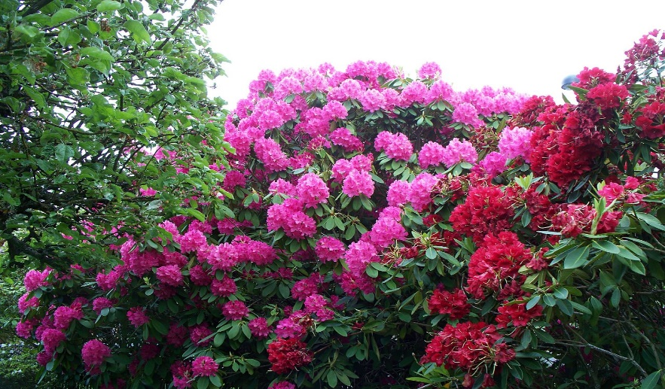
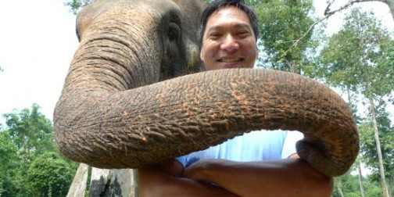
Plants and animals
Plants- There are sunflowers, lotus, delias, guras and sunakhari etc.
Animals - There are wolves, elephants, dogs, cats, pigs, horses etc.

Slide 8
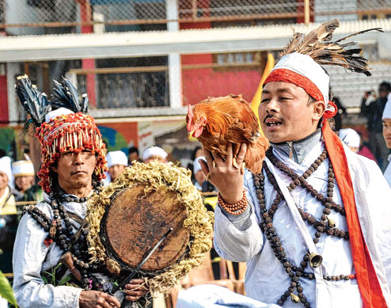
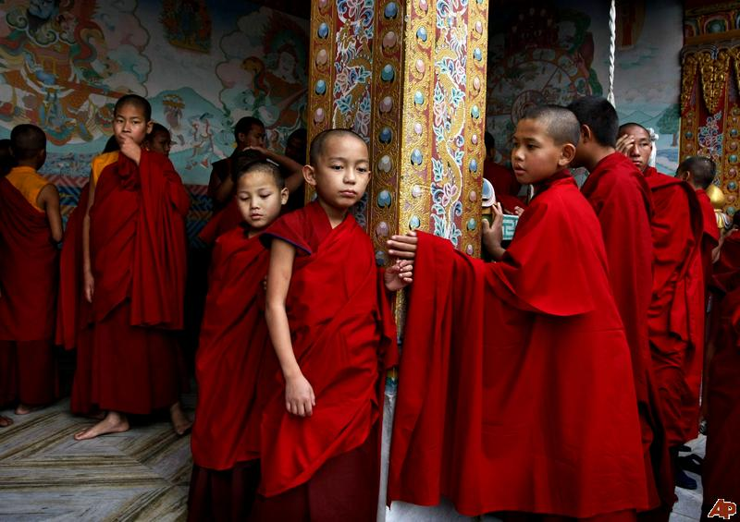
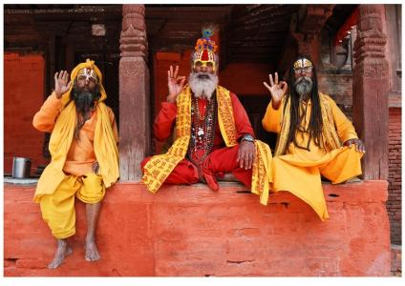
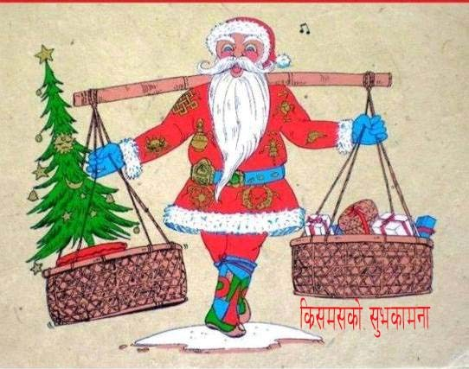
Religions
Buddhism , Hinduism , Kirati, Christian, and other religions are in Nepal.

Slide 9
My story
My story is not very long. We left Nepal in August-02-2015. On that day, everyone was there to see us. I miss Nepal so much because in Nepal there were many friends of mine and I really miss my church and people because everybody in our church was so helpful and friendly. My beloved parents were leaders/helpers of that church. I miss our old bamboo house, more than other buildings I love bamboo houses. I miss everybody and everything. But now we have come here and its alright. I love America and I love Edison Tech High School. That’s all. Lastly, I miss my country Nepal so much and I love my present days, Thank you.

Slide 10
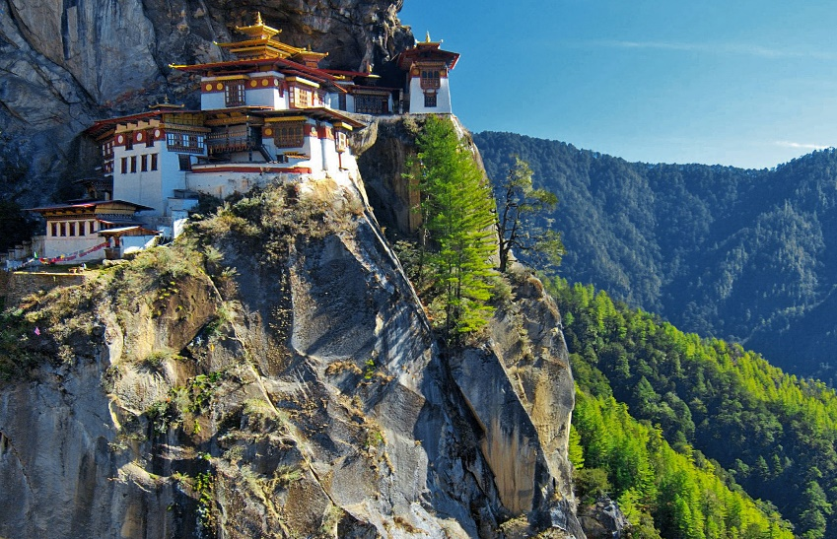
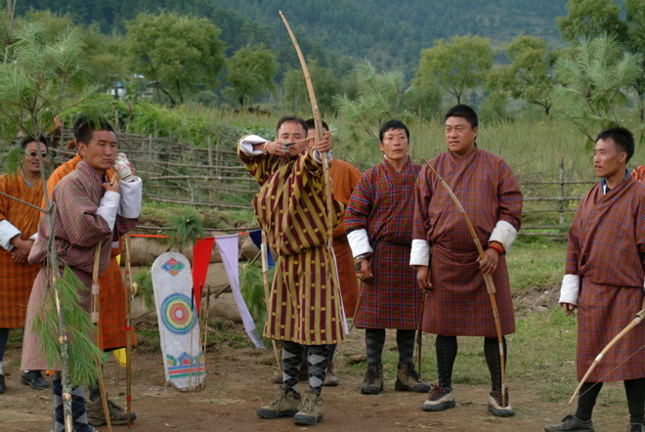
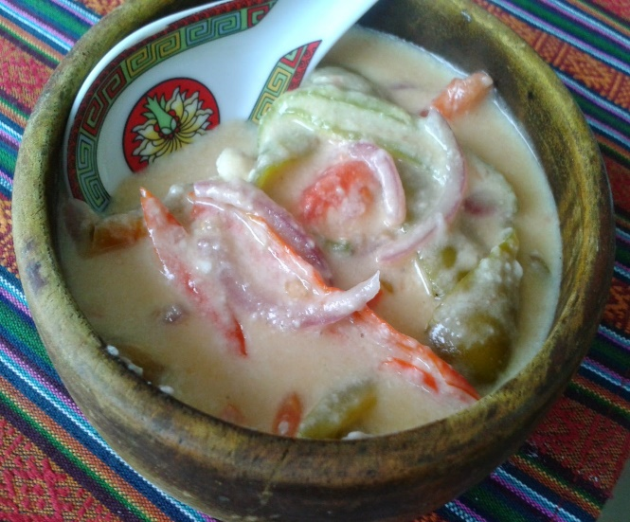
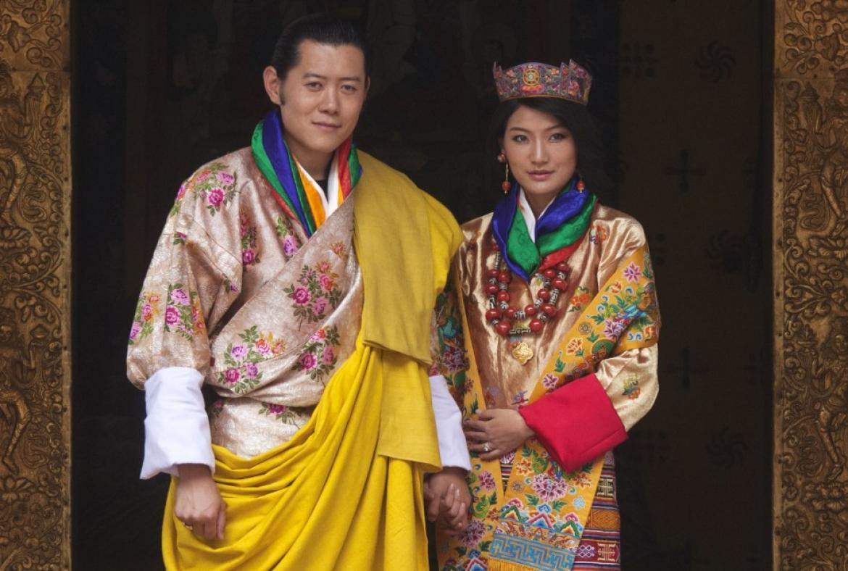
A Place I want to visit in the future:
The place I want to visit in the future is Bhutan because it is a perfect place to visit. The places of this country are very exciting. The food, I like their food, it’s called Aema Dachhi. I like that country’s dresses and it’s called Kira and Xupa. The people of that country speak Dzongkhag and I like that language. The games in this country are very different from others. I wish I could be there.

